Slide 1
Eagle: Schematic and PCB Design
By Sahil Gandhi and Liz Xue

Slide 2
Downloads:
Eagle: https://www.autodesk.com/products/eagle/free-download
Libraries: https://goo.gl/qxKHZW
Add these libraries to the lbr folder of Eagle (after you download it)
For Windows -> C:\EAGLE {$version_num}\lbr
For Mac -->$EAGLEDIR/lbr

Slide 3
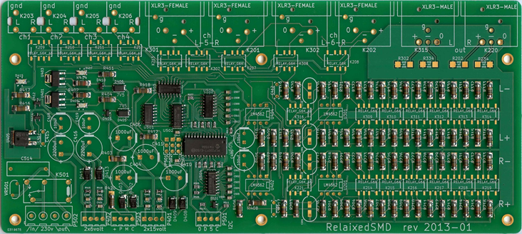
What is a PCB?
Printed circuit board
No wires ... use traces instead
Specific circuit design
After fabrication, cannot be changed

Slide 4
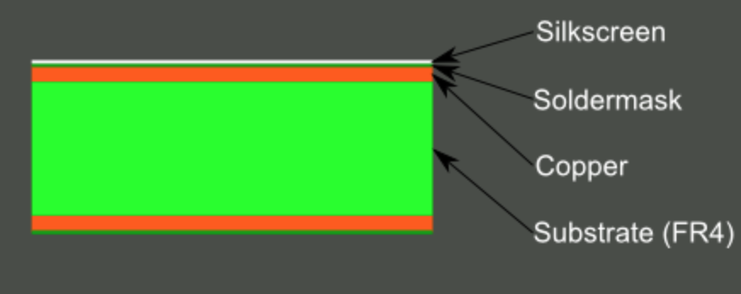
What is a PCB? (continued)
The layers of a double-sided PCB

Slide 5
What is EAGLE?
Software for PCB design
Provides schematic and layout visualization
Freeware
– limited to 4x3.2 in
–2 signal layers (Top Bottom)
–2 sheets for board editor

Slide 6
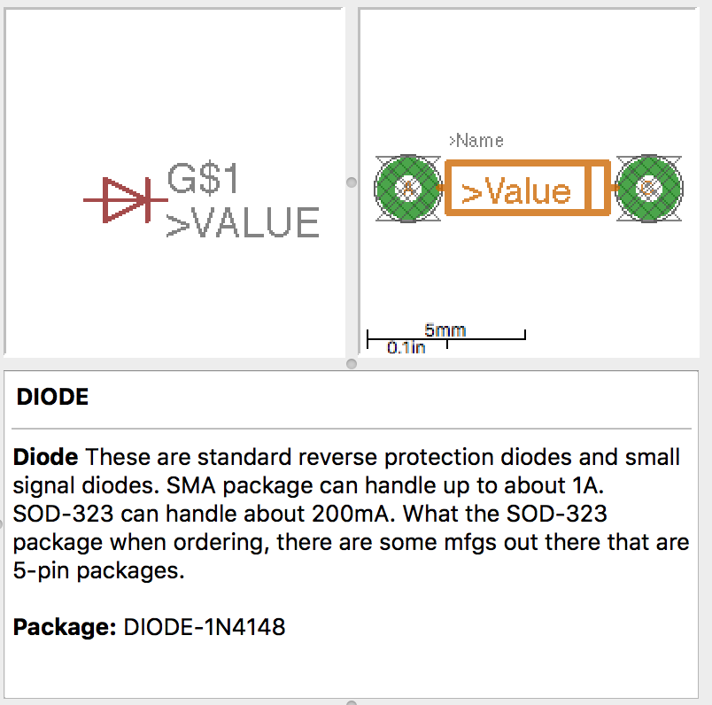
Eagle Libraries
Schematic symbol →
← Device on board
← Package Description

Slide 7
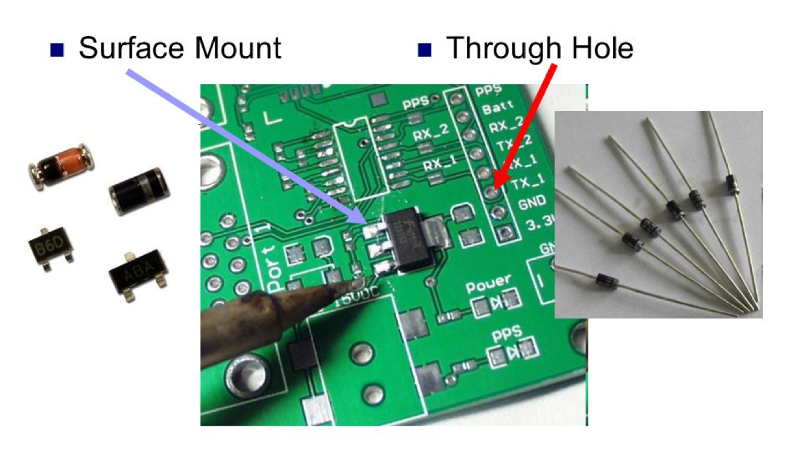
PCB Components

Slide 8
Schematic

Slide 9
Navigating Eagle
Locating libraries
Using libraries
Creating a new schematic
Adding a new part
Other basic commands
Electric Rule Check

Slide 10
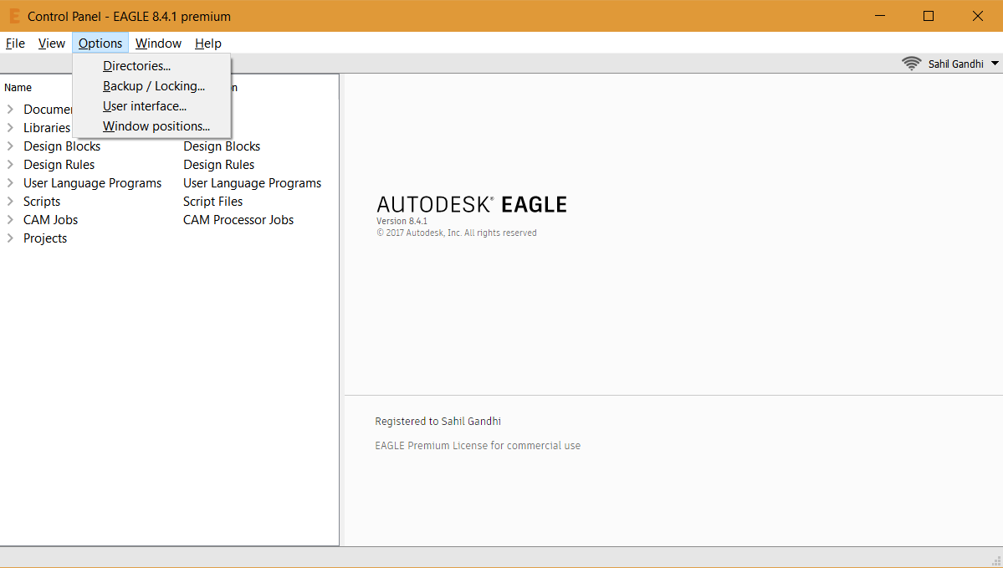
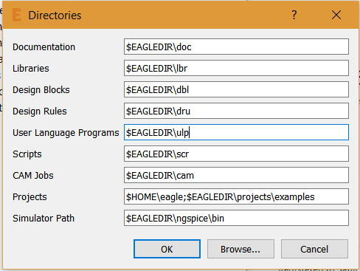
Locating Libraries
Hopefully you know where you downloaded your libraries
Option > Directories
Top dir of where you downloaded libs

Slide 11
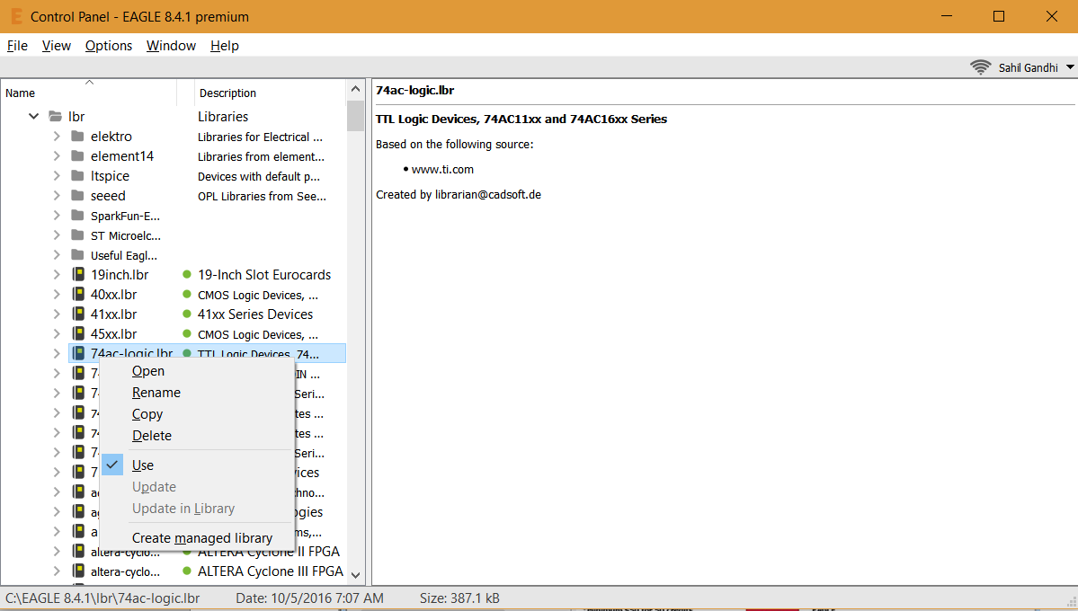
Using Libraries
Right click on the library or on the folder
Select “Use” or “Use All”

Slide 12
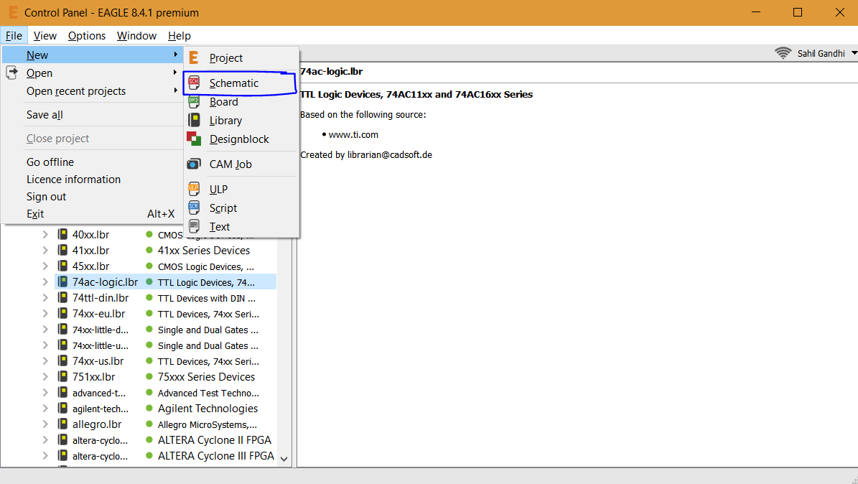
Creating a New Schematic
File > New > Schematic

Slide 13
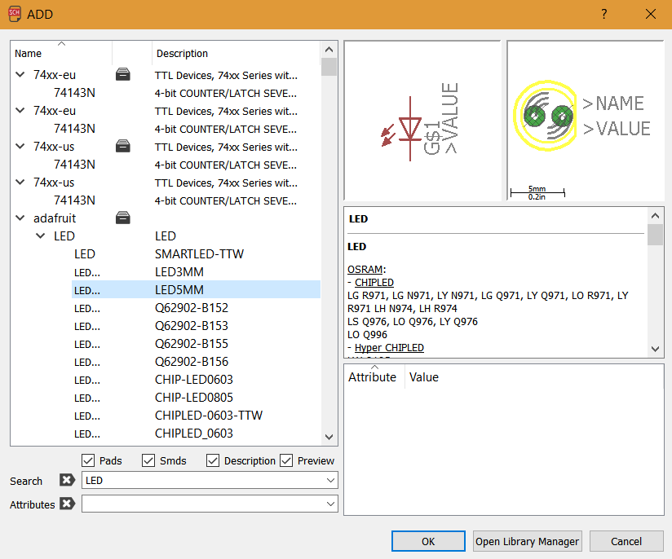
Adding a New Part
Text Based or Click Based (adventure)
Type in add (then hit enter) and menu pops up

Slide 14
Basic Commands
Add parts to schematic → add
Move components around → move
Rotate components → rotate (or just right click)
Delete components → delete
Wire the circuit → net (not wire!!)
Name the components → name
Label them → label
Define the value → value
Verify connections → show
Misc commands -> Right click component

Slide 15
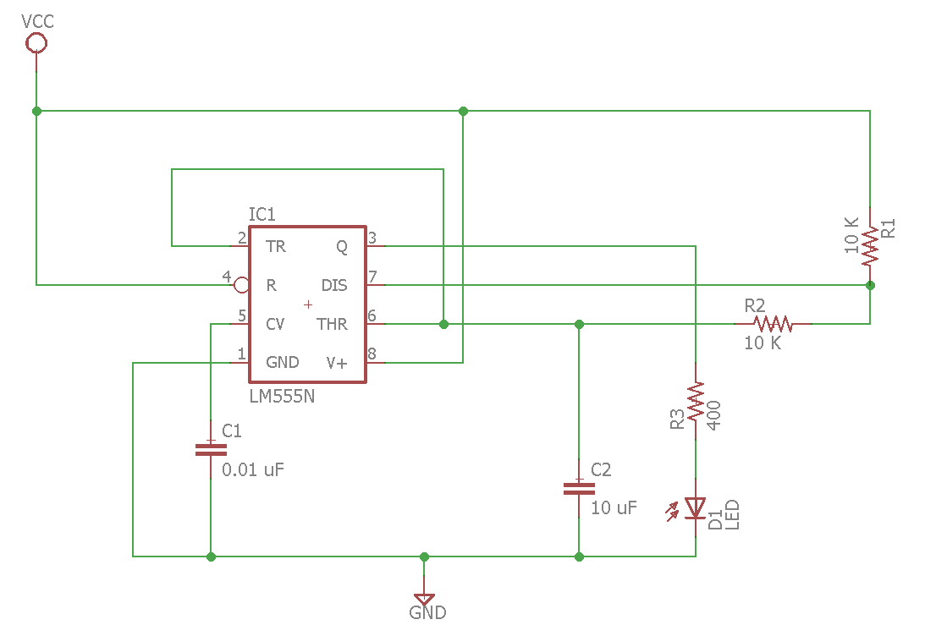
Our Schematic
Parts needed:
VCC
Search for VCC
GND
Search for GND
555 Timer
Search for 555
Capacitor
Search for capacitor
Resistor
Search for resistor
LED
Search for light emitting diode or diode

Slide 16
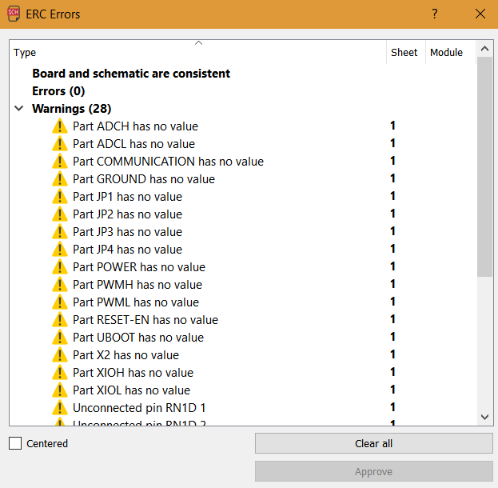
Done with the schematic? ERC Time!
Run the ERC (electrical rule check)
Checks for sound connections and other electrical errors

Slide 17
Board

Slide 18
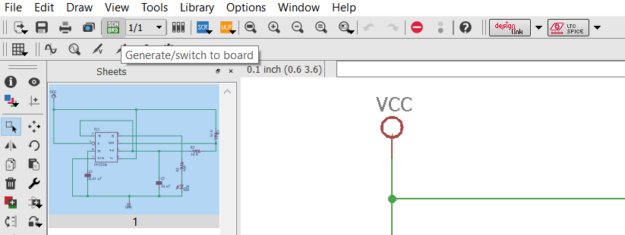
Generating the Board Layout
Click on “Generate/switch to board”

Slide 19
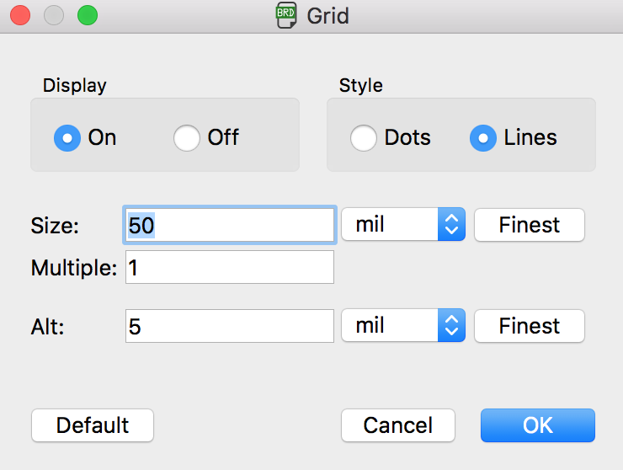
Changing the Grid
- Change to mil

Slide 20
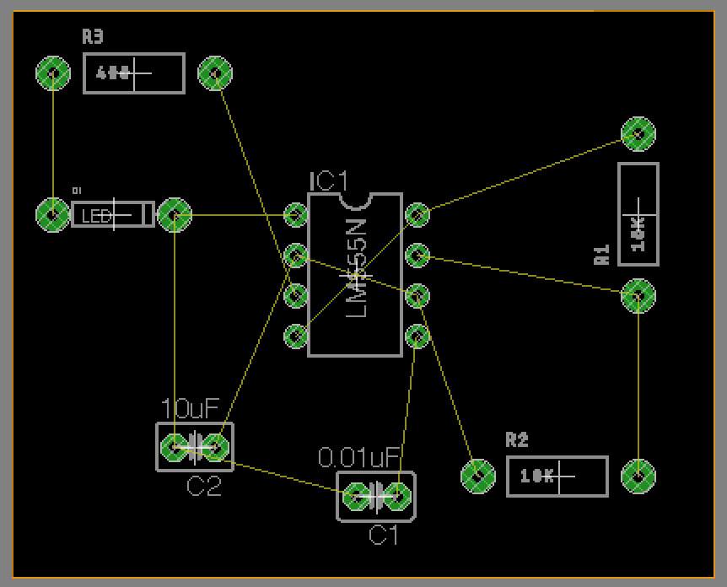
Board Layout
The orange line designates your board
Create a polygon on the “Dimension” layer
Minimize the area of the board outline
A smaller board is a cheaper board

Slide 21
Other Board Layout Tips
You cannot delete objects (resistors, capacitors, etc) from the board
What happens in the Schematic is updated in the Layout
Reset the stage through the Schematic Window

Slide 22
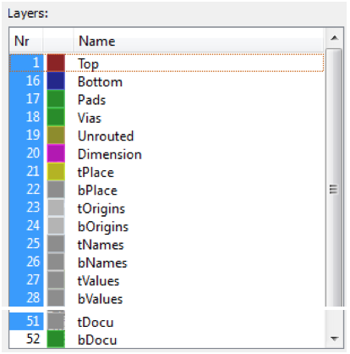
The Different PCB Layers
These distinguish where each part goes on the PCB.
Layers 1 and 16 are Top and Bot for copper pads
Layer 21 tPlace is a silkscreen
Layer 22 bPlace is bot silkscreen
Layer 23 tOrigins is origins for top parts
Layer 24 bOrigins is origins for bottom parts
Layer 51 tDocu is specific documentation
Layer 25 tNames for unique components
Layer 27 tValues for part values

Slide 23
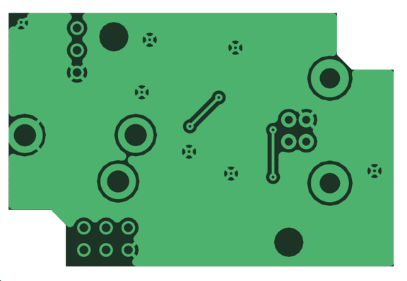
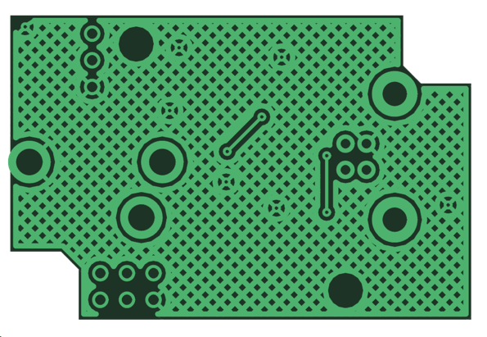
Copper Pours
A layer of conductive metal: copper
Powerplane/groundplace for low resistance
Full layer vs Hatched (lower impedance, better for high freq traces)
Backoff - Distance from a pour to a component

Slide 24
Creating Copper Pours/Polygons
Type in Polygon
Adjust Isolate setting → gives clearance to other signals
Draw a set of lines→ closed contour
Name the polygon
RATSNEST to display the polygon and resolve some wires
RIPUP to switch back to outline mode

Slide 25
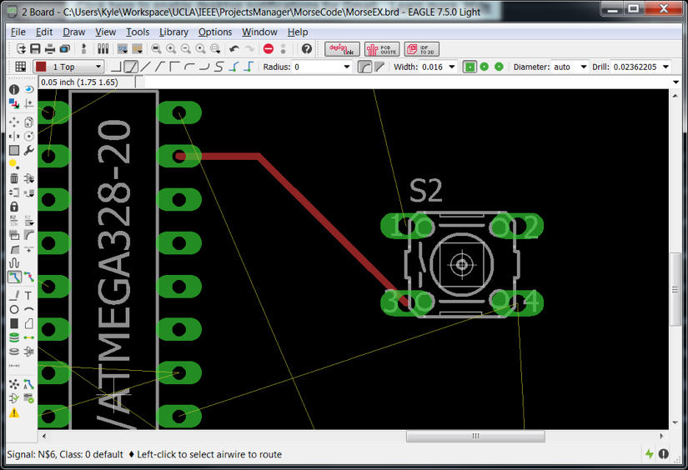
Traces
Use route and ripup
Click on a green circle
Use the 45 degree angles
Why? No real reason tbh (tradition)
Dielectric breakdown(high voltage arcing)
Can change size of trace with Width:
Larger trace, less noise, more current go through

Slide 26
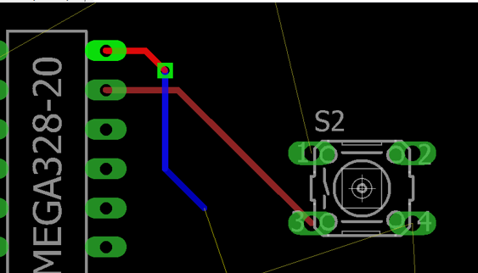
Vias
Vias are electrically conducting holes through the board
Why use them?
Some electrical routes are tricky
Utilizing multiple planes
Created via middle/scroll click

Slide 27
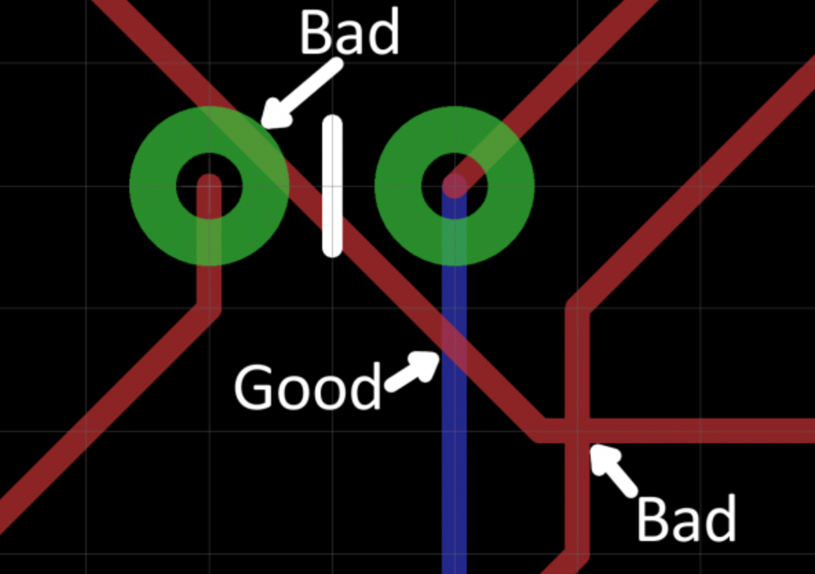
Avoid Overlaps!

Slide 28
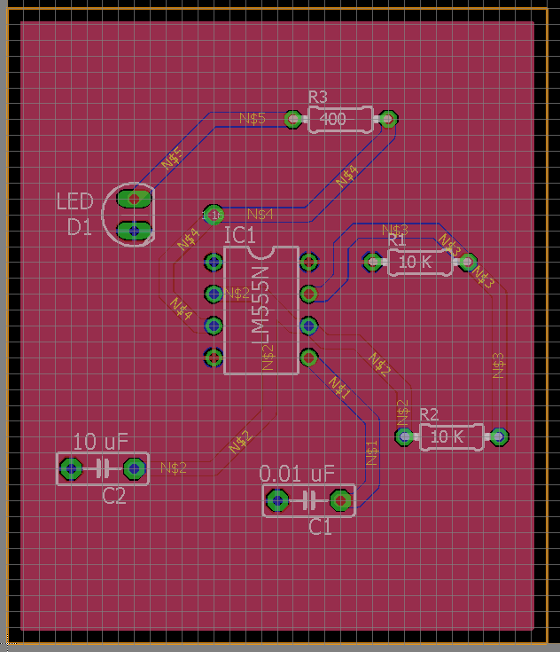
Final PCB Layout

Slide 29
Design Rule Check (DRC)
DRC is useful to prevent errors in your PCB
Download from
https://oshpark.com/guidelines
After routing, type in DRC and click on Check

Slide 30
Everything Looks Good? Gerber File Creation
The producer needs necessary file to recreate your PCB
Download those here (depending on EAGLE version)
http://docs.oshpark.com/design-tools/eagle/generating-custom-gerbers/

Slide 31
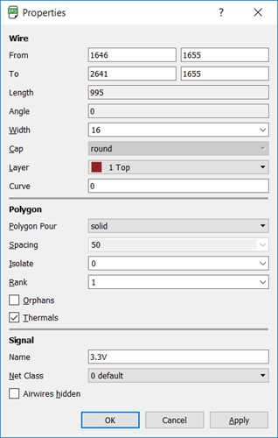
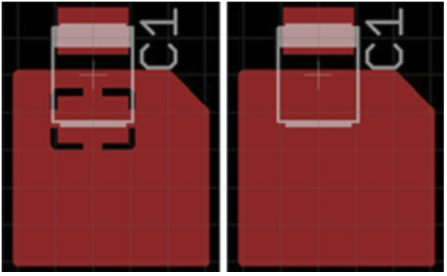
Advanced Topics: Polygons + Heat
Thermals help make soldering easier (part heats faster, heat dissipation is slower)
Remove thermals for high power traces
More surface area = more heat dissipation
Do so with vias
Multiple traces/pours
Can stack polygons with rank

Slide 32
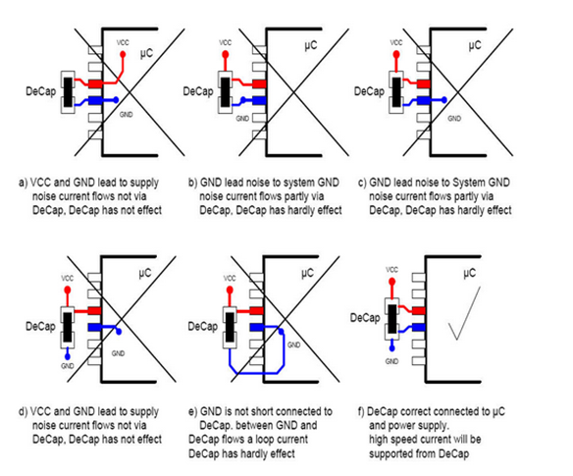
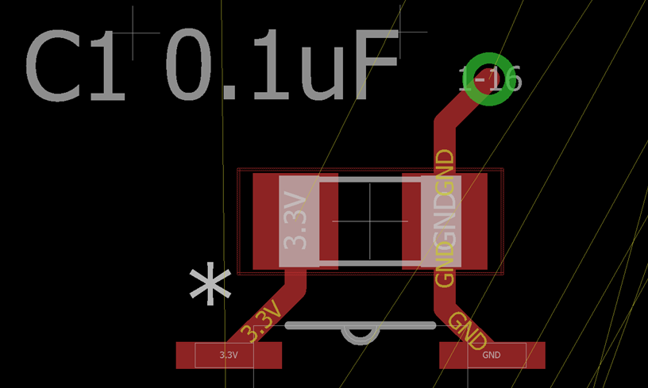
Advanced Topics: Decoupling Capacitors
No perfect sources
Prevent spikes and drops in voltages
Support non-ideal situations

Slide 33
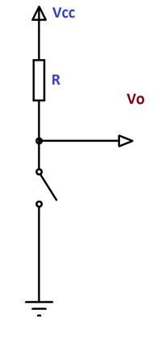
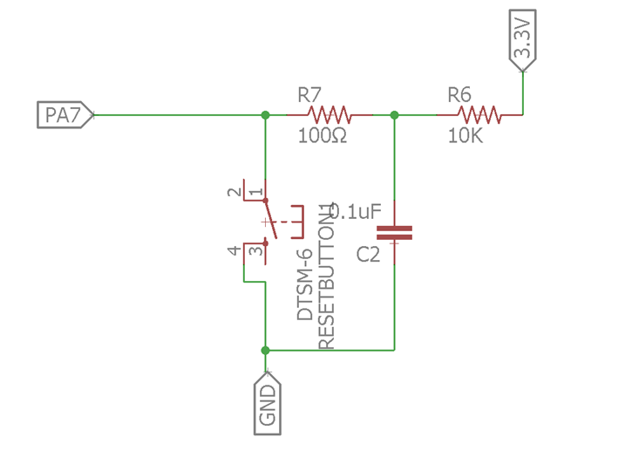
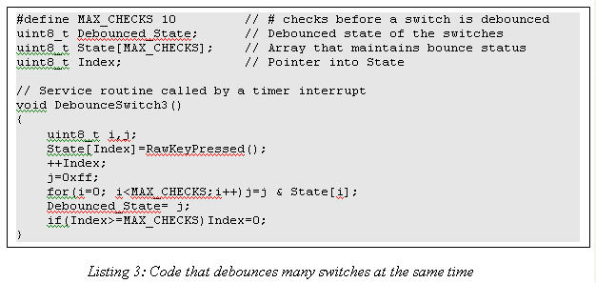
Advanced Topics: Debouncing (Software vs Hardware)
Software Debouncing
Hardware Debouncing

Slide 34
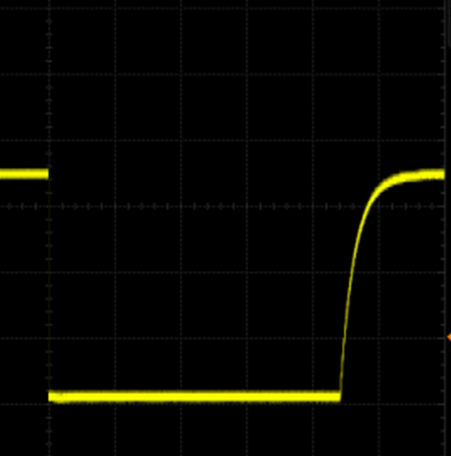
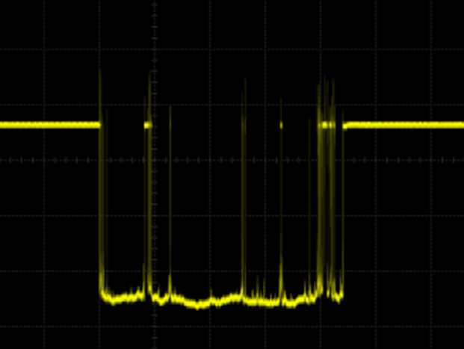
Advanced Topics: Debouncing (cont.

Slide 35
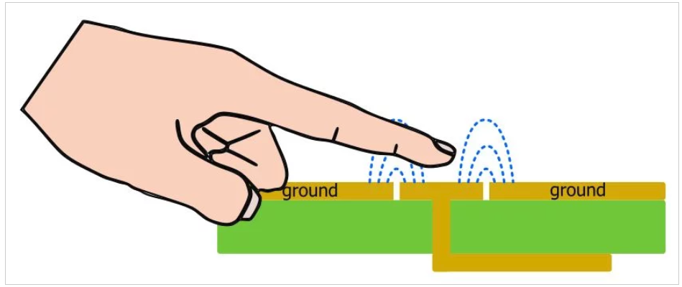
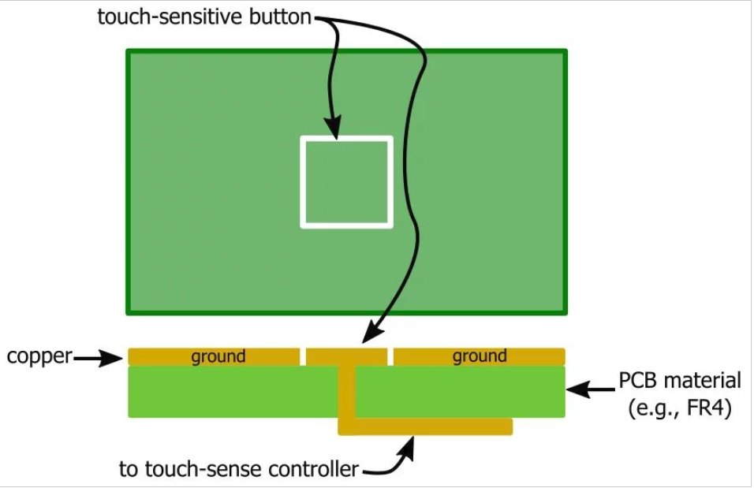
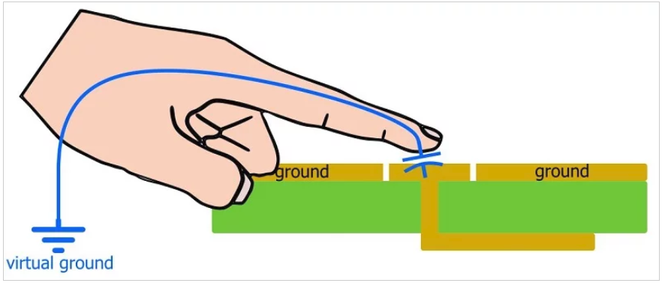
Advanced Topics: Capacitive Touch Sensing
Using finger as dielectric or conductor to stimulate change in circuit
Look for libraries specific to CTS

Slide 36
Final Thoughts:
Different types of footprints
More extraneous traces for a component
Size of your components
Removing the silkscreen

